Slide 1

TACKLING CUSTOMER SUPPORT THROUGH NLP
TEAM 17
18K41A0505 AREEFA
18K41A0528 K. PRAGATHI
18K41A0529 K. RISHITHA
18K41A0556 KUSUMA SRI ABHINAY
18K41A0415 G. LEENA
MENTOR: VENKATRAMANA V

Slide 2
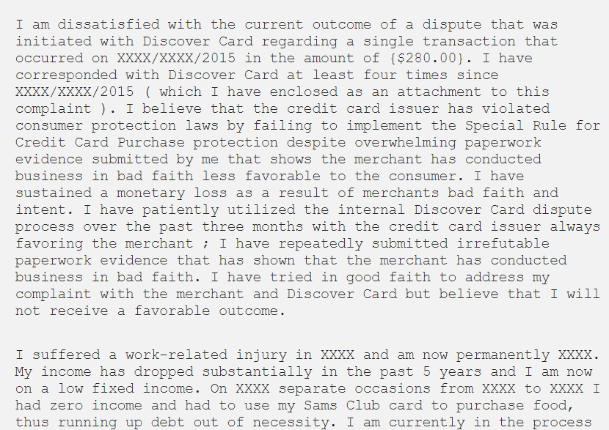
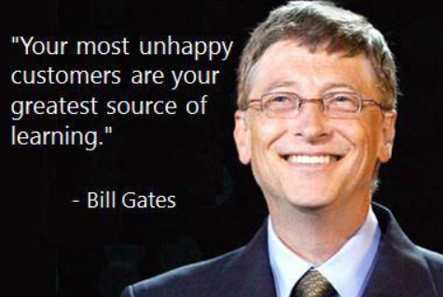
Who has time to read a whole chunk of text?
with no headers, no summary and terrible formatting (bold, spacing, etc.) that potentially holds no relevance to you
NEED STATEMENT:
Typically, in banks (or any customer service department of large companies), they see thousands of complaints like these on a daily basis and they’re not exactly going to be as pleasantly phrased and formatted as the ones above.
There is a need to automate this with the help of ML model with NLP support!

Slide 3
Survey
Many big bank companies maintain a traditional Customer support service – Call centers.
At times, it becomes hectic to tackle complaints of customers with various problems and manually connecting them.
Many systems are working on the sentimental analysis of the complaints but are not feasible to just rely only on sentiment.

Slide 4
LITERATURE SURVEY:
Banks that accept client complaints will examine the data to see where the most grumbling is stored, what objects / organizations are generating the most problems, and other pertinent information. The methodology could aid banks in gaining a better understanding of the region and types of target mix-ups, as well as encouraging widespread buyer participation to enhance wages and profitability.
In today's world of information management technologies, processing client complaints is a huge difficulty. Anon et al[6] developed a model approach for improving automated customer complaint processing. They've demonstrated how communicative acts and attack links may be effectively described using the graph-based representation supplied by the complaint scenario. They've also demonstrated that their proposal for classifying complaint scenarios using supervised learning.

Slide 5
In another study, Xu et al [1] clustered customer complaints from mobile service providers using the K-means cluster analysis algorithm. The research focused on the creation of explanatory notes for complaint orders and the subsequent design of these orders. The study also performed statistical analysis on the complaints group, which is beneficial to the customer complaints group and clustering.
According to Hsiao et al [2], an experimental study was carried out for a group of restaurants in Taiwan. The aim of the study is to analyze and process customer complaints as well as to forecast and improve service quality. The decision tree methodology was integrated into Six Sigma analysis tools in this study and the results indicate a decrease in customer complaints.
Yang et al [3] presented a model for classifying customer complaints at a telecommunications company. Previous research has focused on decision support systems for handling complaints, while this study suggested the use of decision support systems based on (ER) conclusive arguments. The proposed model offers high performance in improving customer complaint handling.

Slide 6
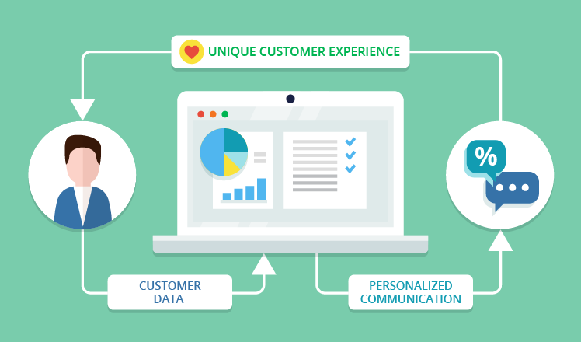
Analysis of Research papers:
According to a research paper dealing with a ML model with Customer perception analysis told of need to connect the customers with right customer care is a leading problem to decrease the response or waiting time.
Hence, NLP plays an important role in tackling this problem.

Slide 7
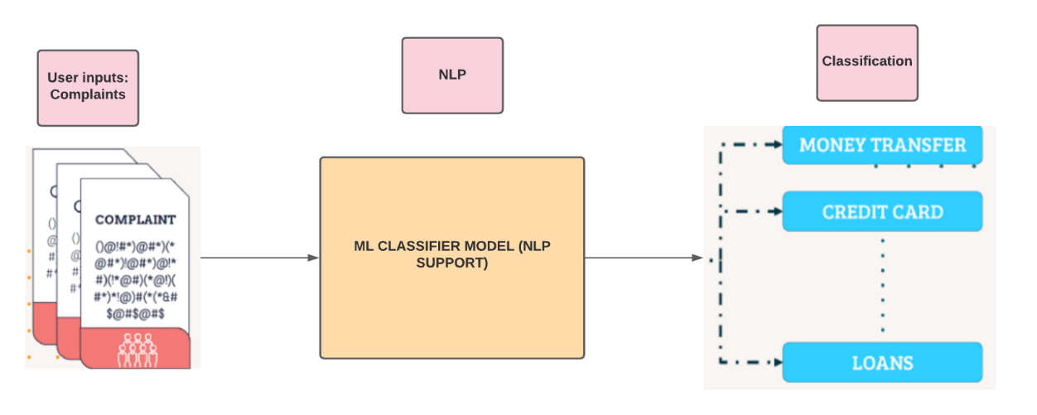
PROPOSED MECHANISM

Slide 8
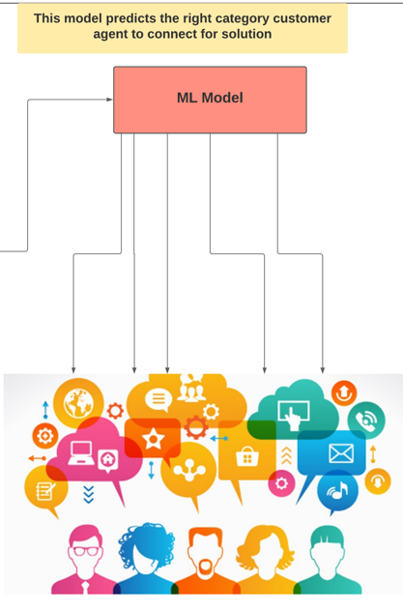
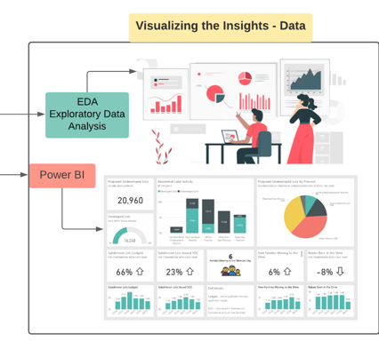
PART 4
PART 3
PART 1
Gathering Data
Pre-Processing
NLTK
Customer Complaints
PART 2

Slide 9
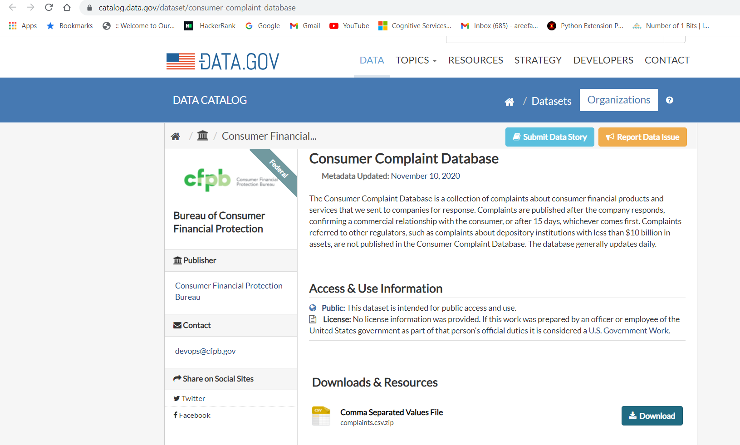
PART 1: Gathering Data
Labelled Dataset is provided by Consumer Financial Protection Bureau (CFPB).
Initially, 1,437,716 rows
18 columns

Slide 10
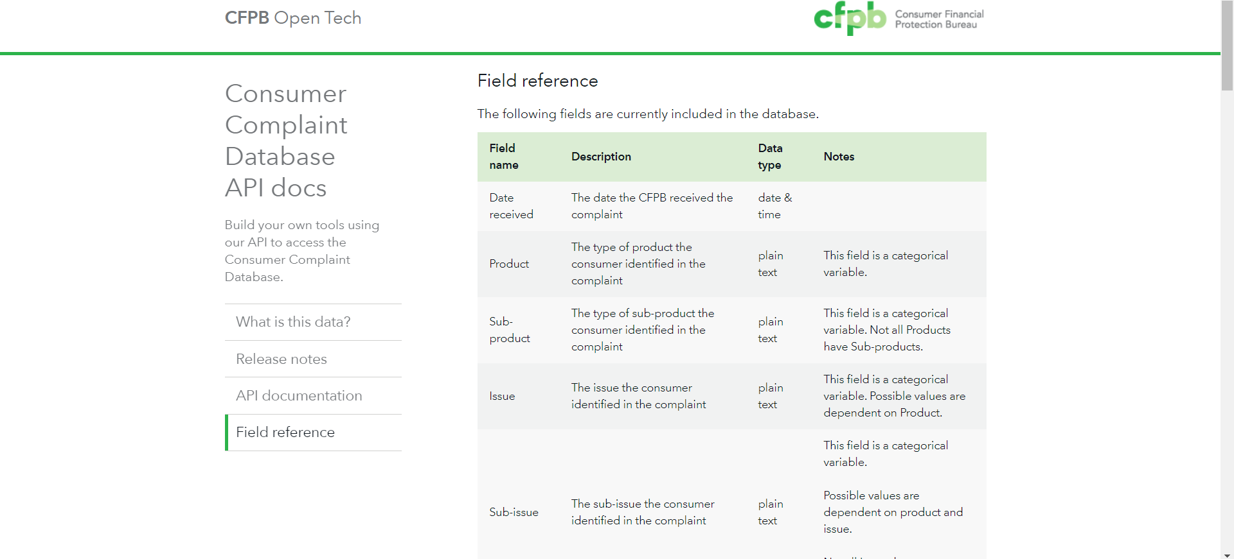
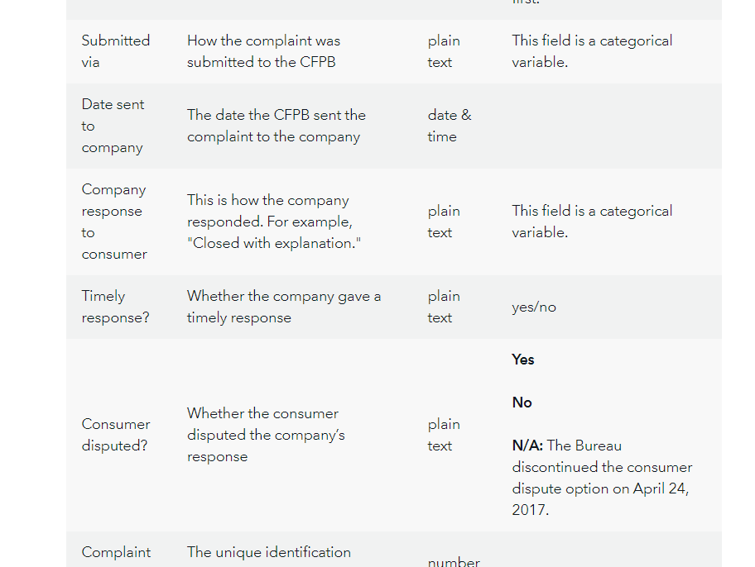
Consumer Complaint Database

Slide 11
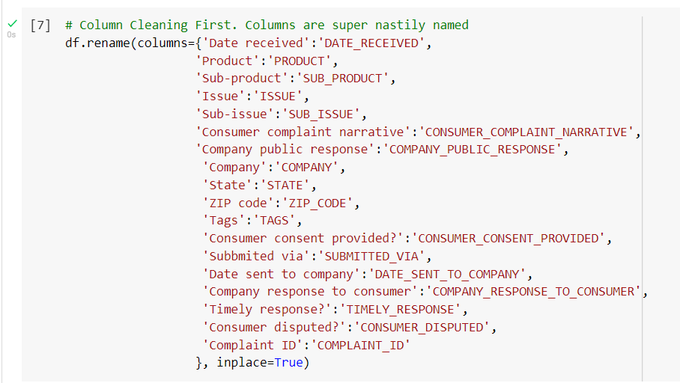
Next Steps done!
Dropping all rows that do not have Customer Complaint entries in them. – NULL values
Subsetting Dataframe for Text Multi-Classification Problem
Understanding/Cleaning Our Data
Dropping the columns not needed.

Slide 12
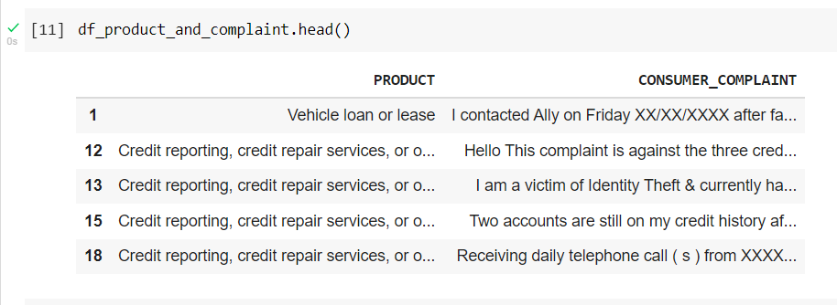
After dropping unnecessary columns

Slide 13
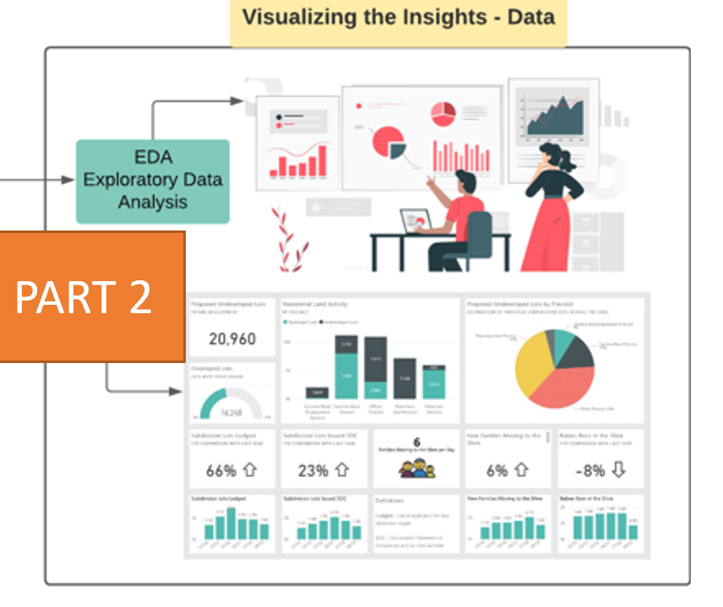
PART 2: VISUALIZATION

Slide 14
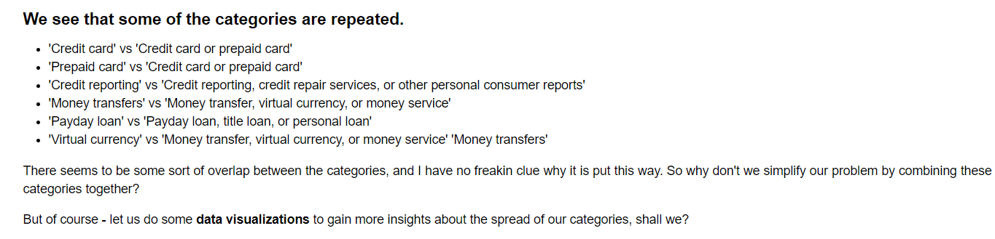
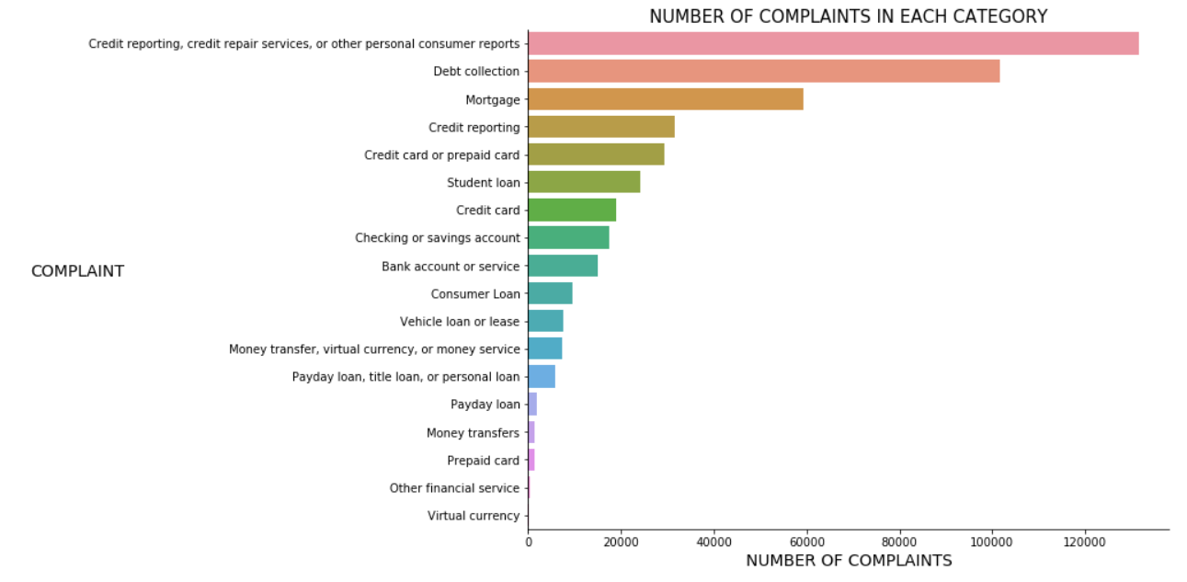
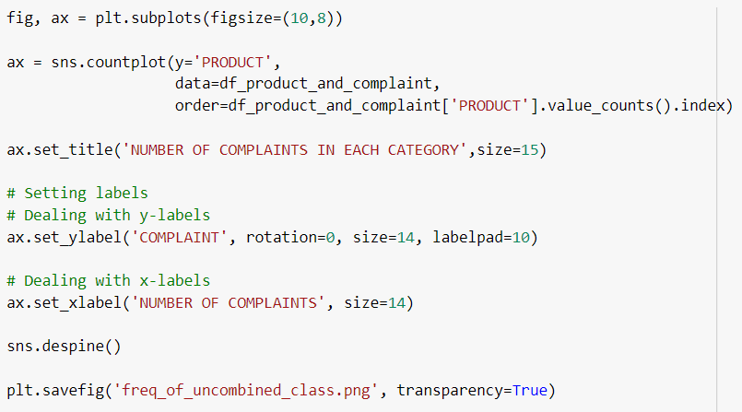

Slide 15
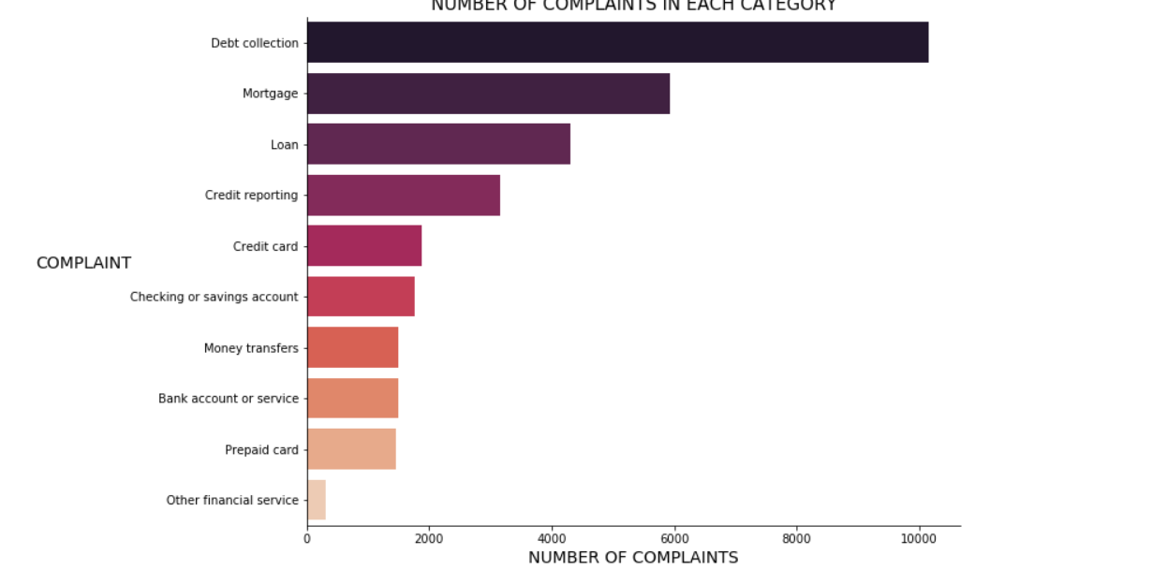
EDA – Exploratory Data Analysis
After reducing the categories that are overlapping:

Slide 16
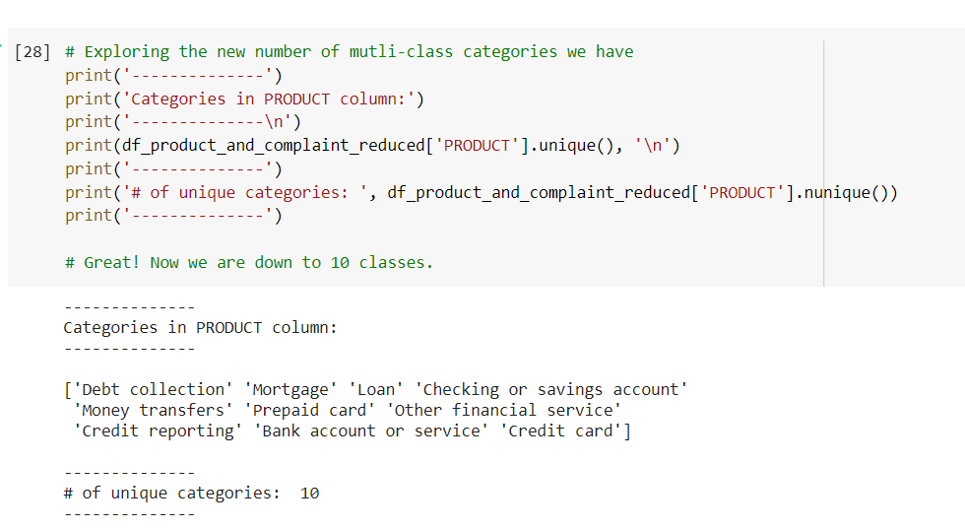
Reduced Dataset:
15196 rows, 3 columns and 10 categories (result)

Slide 17
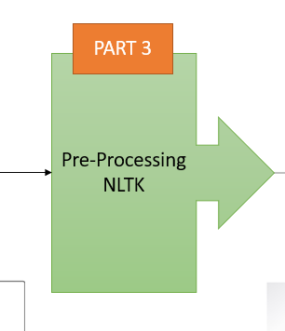
PART 3 – Text Pre Processing
VECTORIZATION:
TF-IDF:
Context-based Vectorization
This is where Term frequency inverse document frequency vectorization comes in (TF-IDF). This vectorization method looks at the number of times a word appears in a comment relative to the number of times it appears in other comments.
Two things result in a higher TF-IDF score:
Higher frequency of the word within the specific complaint being scored.
Lower frequency of the word across all other complaints.

Slide 18
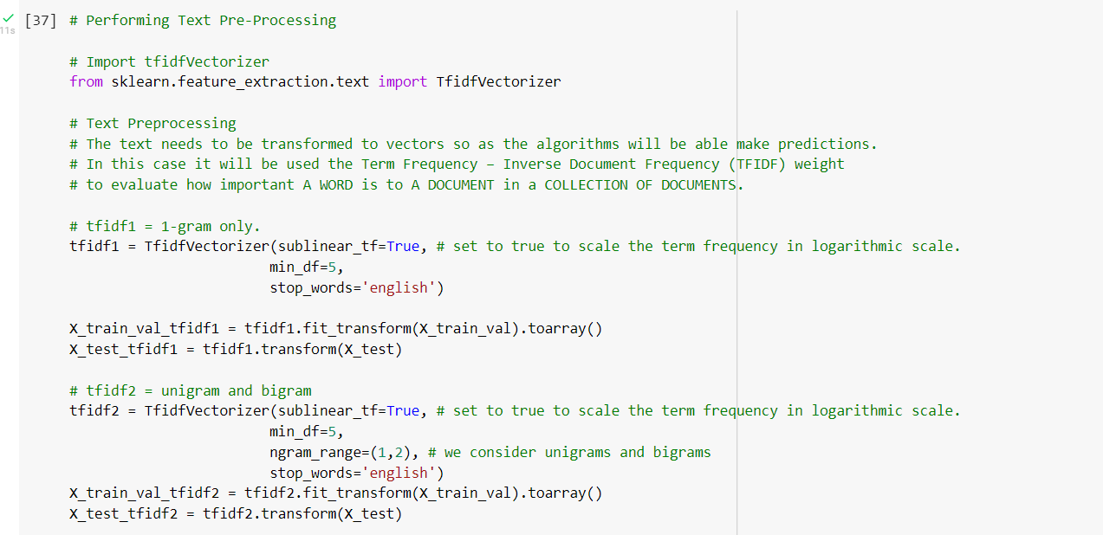
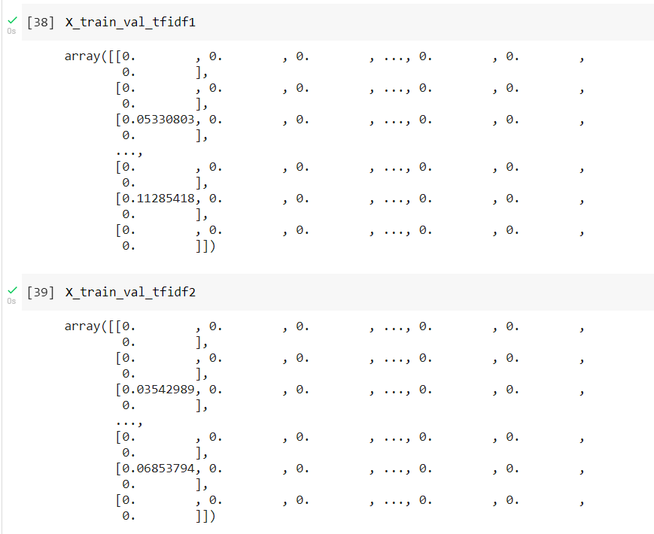
N-Grams:
Neighbouring sequences of items (words, letters or symbols) in a document.
E.g: Not satisfied with loan system.
Unigram: would be a list created of following:
[‘Not’,’satisfied’,’with’,’loan’,’system’] --- (5 elements in list)
Bigram (2-gram) [‘Not satisfied’,’satisfied with’,’with loan’,’loan system’] --- (4 elements in list)
Stop words: frequent words in English that doesn’t provide any useful info.
TIP: Analyze multiple N-grams and see which works best for your particular data science project.

Slide 19
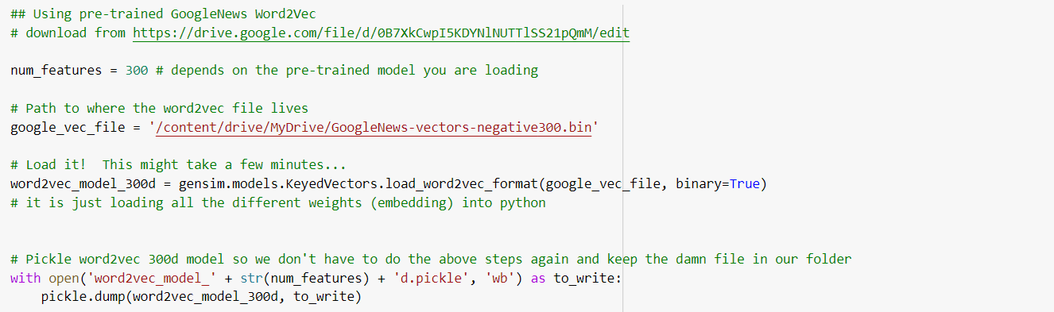
Using GoogleNews Word2Vec300d
The word2vec tool takes a text corpus as input and produces the word vectors as output.
It first constructs a vocabulary from the training text data and then learns vector representation of words. The resulting word vector file can be used as features in many natural language processing and machine learning applications.
Pre-trained word and phrase vectors
We are using pre-trained vectors trained on part of Google News dataset (about 100 billion words). The model contains 300-dimensional vectors for 3 million words and phrases.
Hence, we can say we are using GoogleNews Word2Vec200d for text pre processing method.

Slide 20
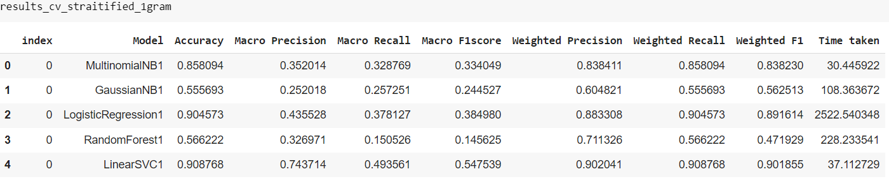
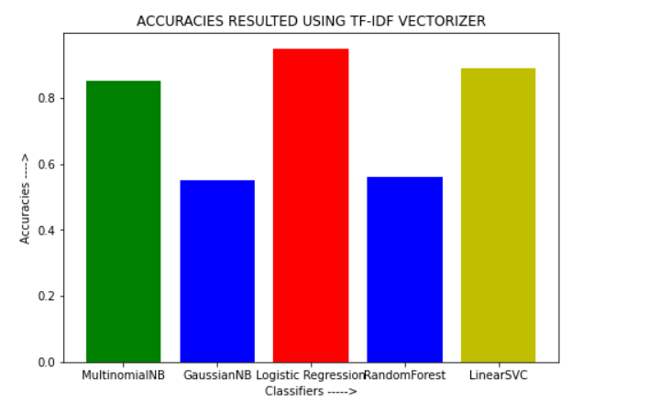
Cross Validation & RESULTS
Using TF-IDF Vectorization

Slide 21
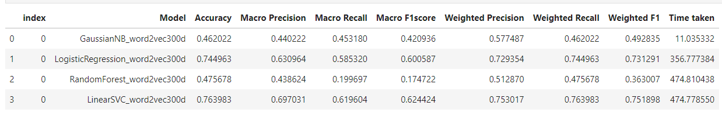
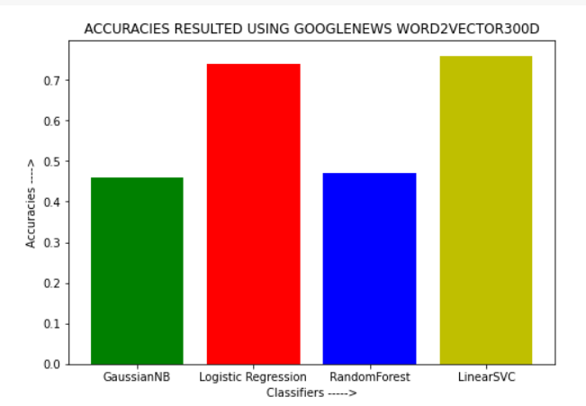
RESULTS
Using GOOGLENEWS WORD2VEC300D

Slide 22
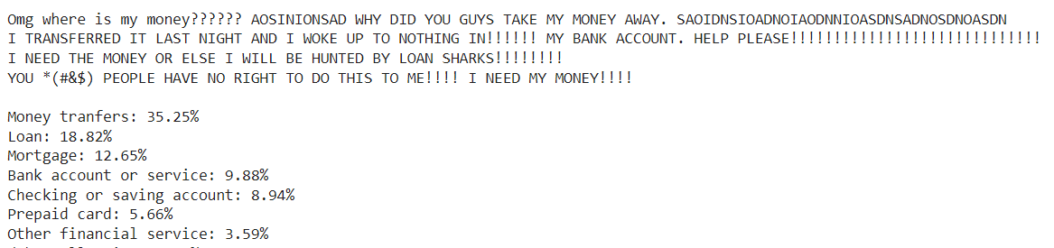
Prediction on new sample

Slide 23


Conclusion:
https://colab.research.google.com/drive/1Xl7aN7zCYxTXHTeRLsW2PHSvQmZTwQLB#scrollTo=JJQuY90GTq0C
The utilization of this app can bring about a plethora of benefits, from freeing up manpower to increasing efficiency of sifting through customer complaints.
Tackling Customer support efficiently!
Scope: This model can be run in backend of the bank applications – customer support. Can be used to train a audio bot.

